Slide 1

Prometheus Monitoring & Integration Testing
Nalin Kant Gupta Sr. SRE - Adobe

Slide 2
Prometheus
Prometheus is an open-source monitoring and alerting system toolkit originally built at SoundCloud.
Second project which accepted in CNCF and graduated in 2018.
Pull based metrics collection.
Extremely high performance TSDB.
Service Discovery.

Slide 3
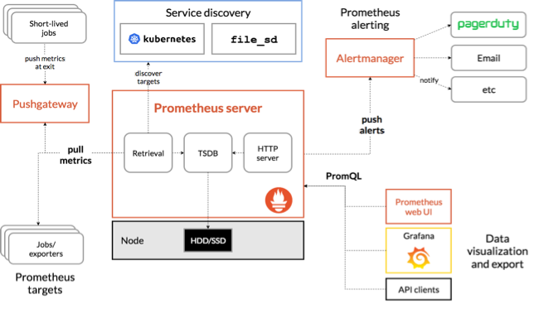
Architecture

Slide 4
Design pattern
1. Decouple Alerting (Application & Host)
2. Remove non-relevant Alerts.
3. Relevant Mesage notification.
4. Label Services

Slide 5
Tooling
Amtool:
It is a cli tool for interacting with the Alertmanager API. which can help you in putting all the validation checks related to the configuration.
Alerts
Silencing
Routes
Promtool:
cli tool for integrity of your Prometheus configuration

Slide 6
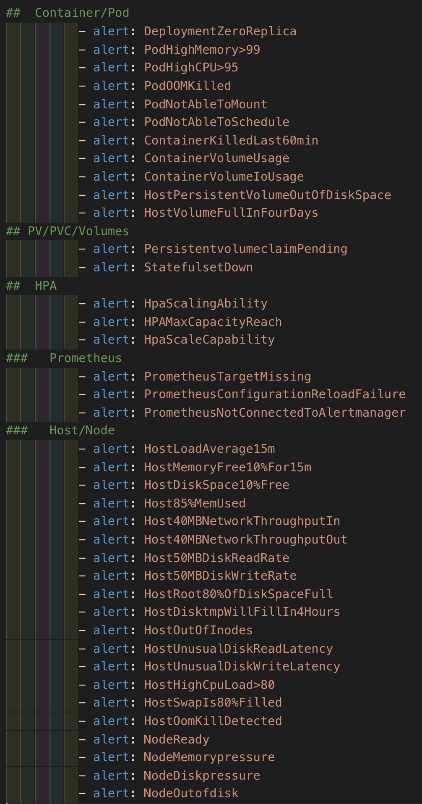
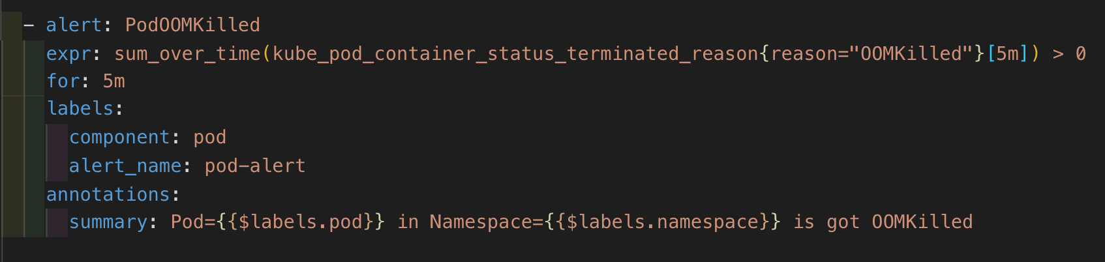
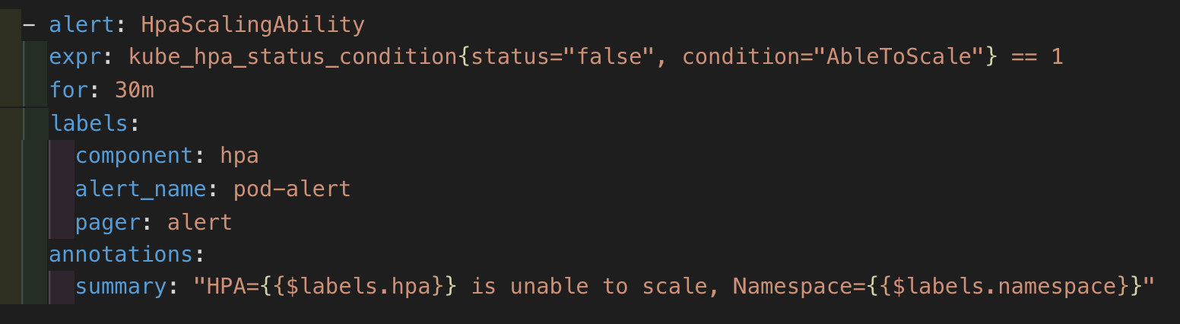
Rules labeling

Slide 7
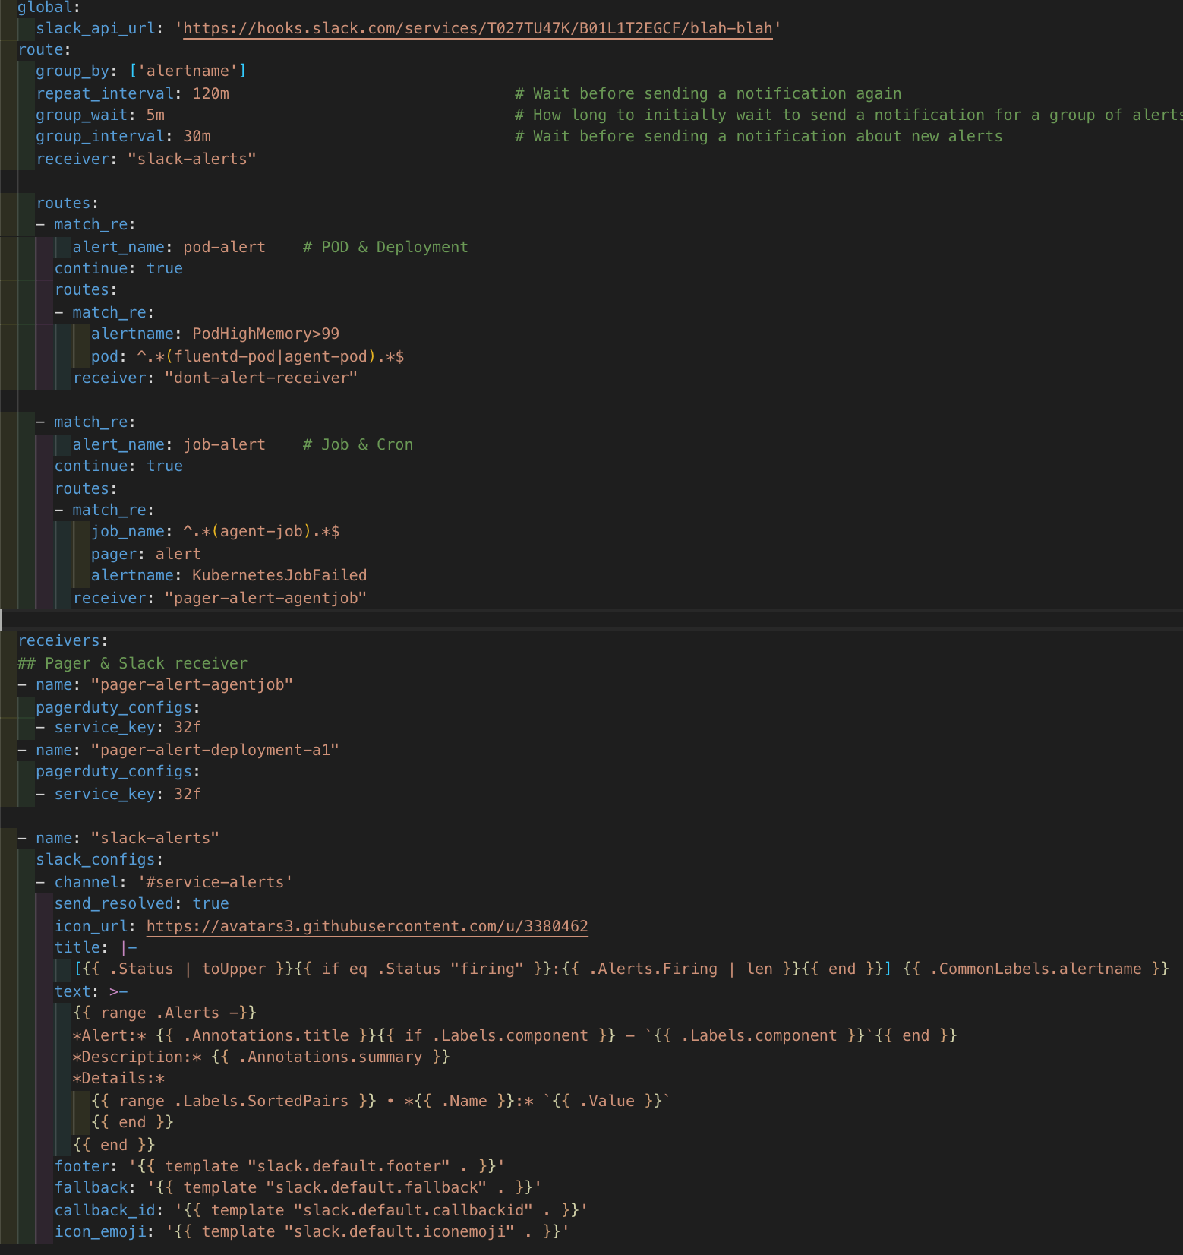
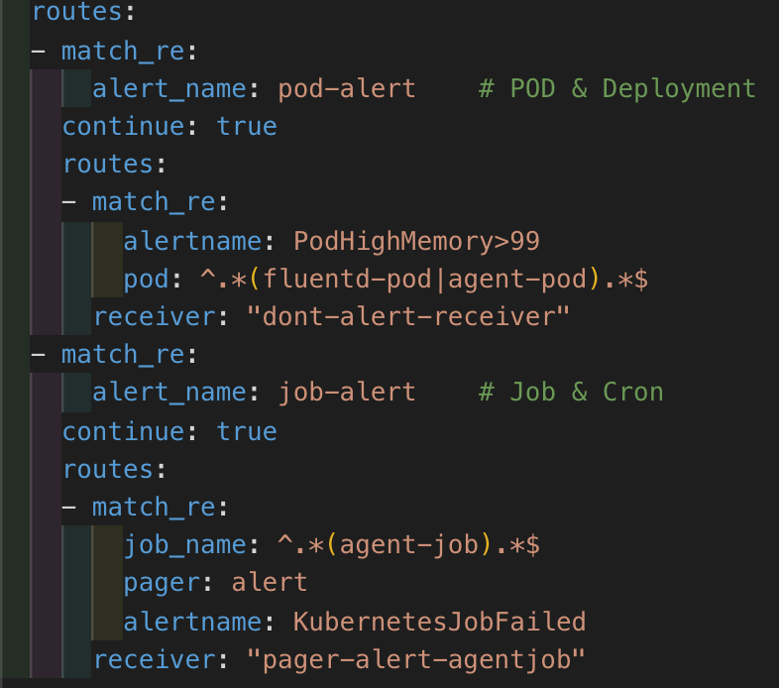
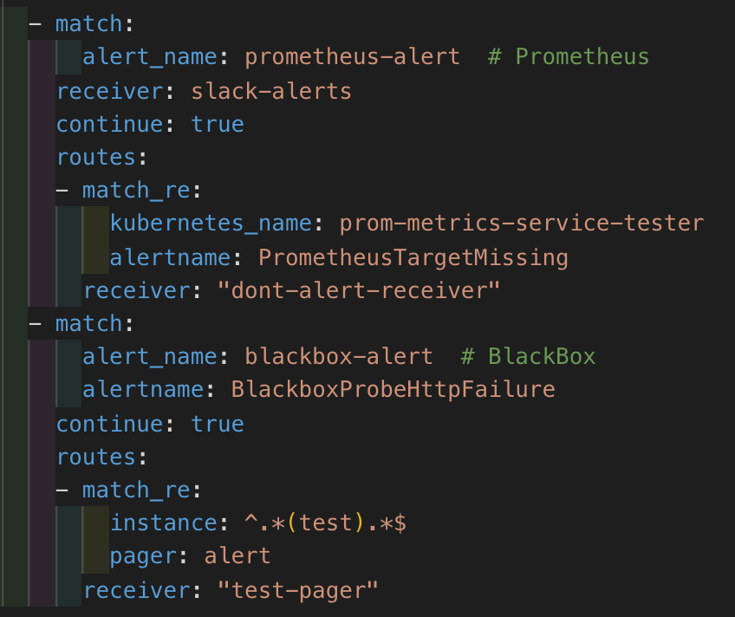
Alerts & Receiver

Slide 8

Integration Testing
Local Testing
Monitoring Integration
Alerting hierarchy.
CI/CD Integration

Slide 9
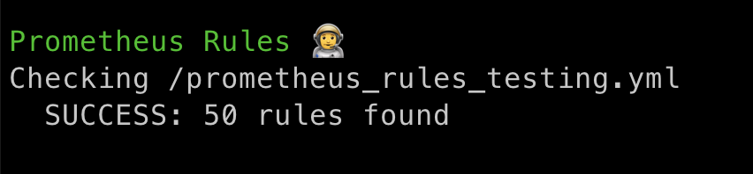
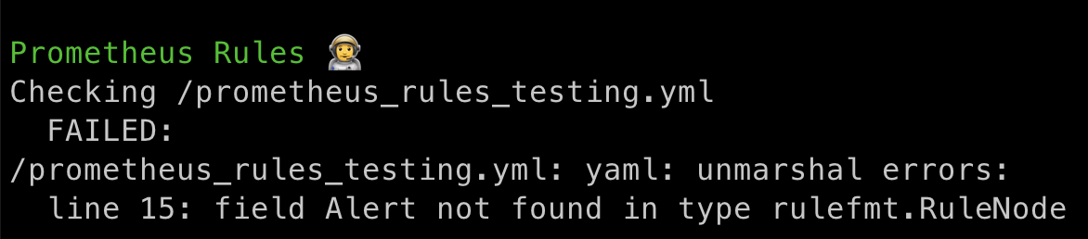
Prometheus Config testing
1. Success
2. Failed condition (Change alert to Alert )

Slide 10
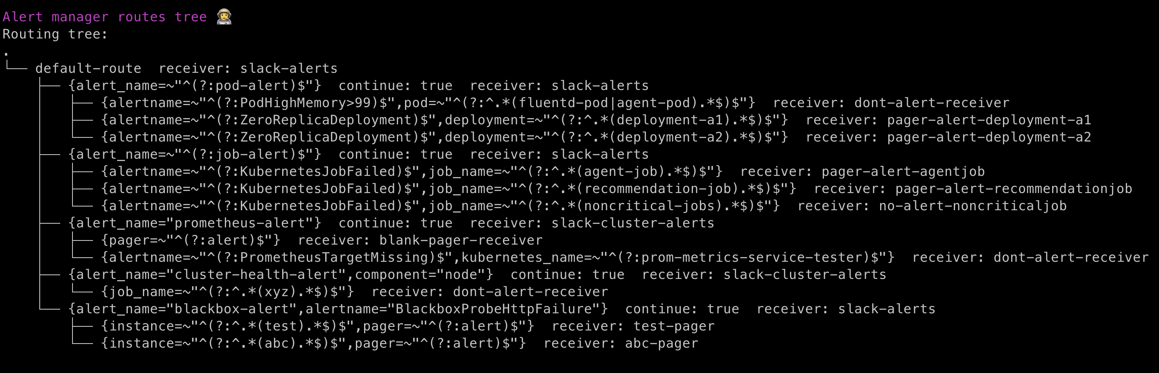
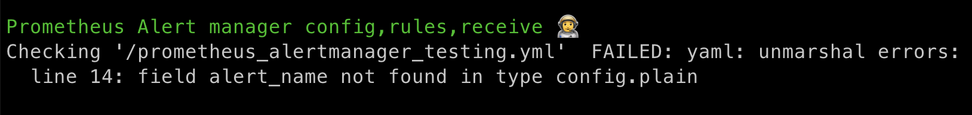
Prometheus Routes testing
1. Success
2. Failed condition

Slide 11
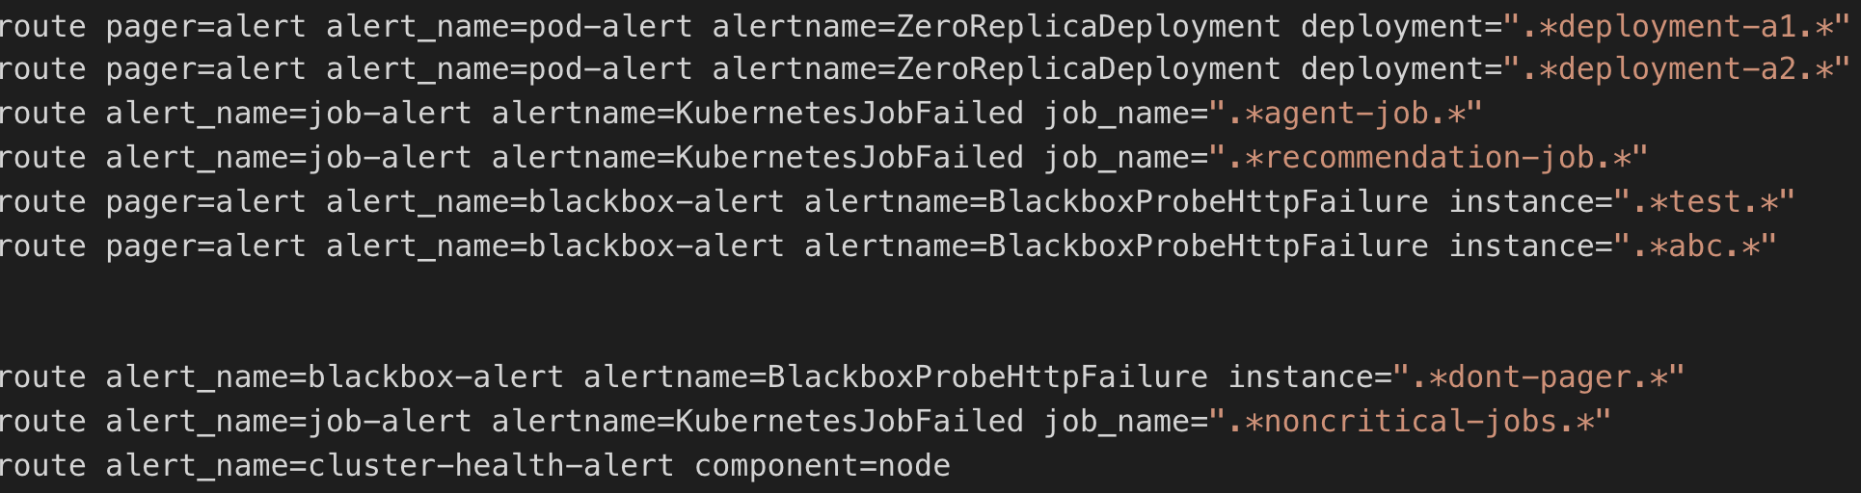
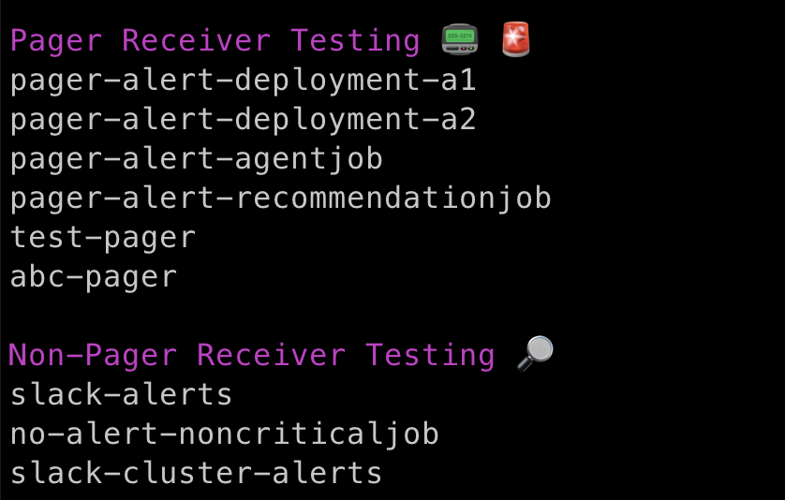
Application integrity
Using alert_name and other labels we are able to fake the alerting and check the receiver whether it is pagerduty or other notification service.

Slide 12

Demo

Slide 13


